Slide 1
Brooklyn’s Best Brewery
Business plan presentation

Slide 2
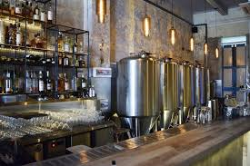

Overview
New York City is the most populous city in the United States. With an estimated 2019 population of 8,336,817 distributed over about 302.6 square miles (784 km2), New York is also the most densely populated major city in the United States. New York City is composed of five boroughs: Brooklyn, Queens, Manhattan, the Bronx, and Staten Island. The city has diverse demographics and a vibrant economy. A resident or visitor to the city can experience a vast array of cultures, including food, museums, and many other attractions.
My goal is to determine the best location to open a microbrewery and tap house in Brooklyn. Foursquare data will be used to determine location to similar venues that will attract foot traffic to the brewery.

Slide 3
Resource Requirements
Business Overview
Microbrewery with tap house in Brooklyn, NY. In-house brewery that brews and serves it’s own craft beer.
Small selection of food options provided. Located near other restaurants to give visitors other food options.
Walking distance to tourist attractions (approximately 1 kilometer)
Demand for the business. No other breweries within 1 kilometer of selected location.
Target Audience: New York city tourists and Brooklyn residents who want an authentic craft beer brewed and served on site.
Data methodology:
Foursquare API
Search for locations of popular venues
Concentration of nearby venues

Slide 4
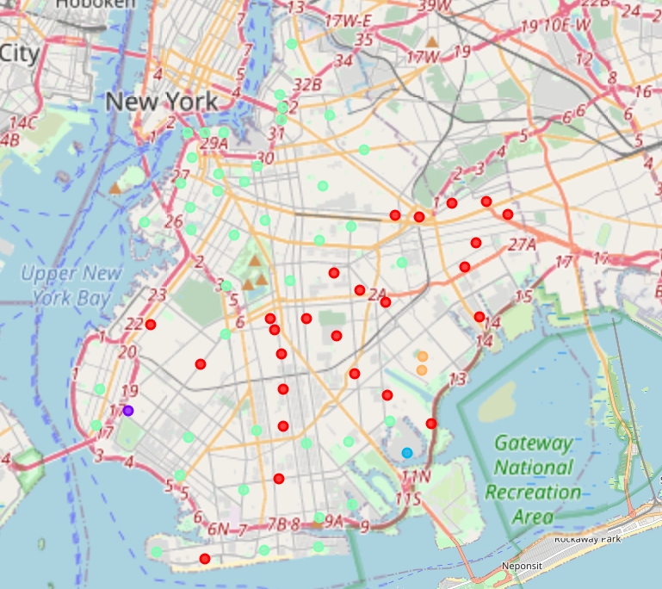
Data Analysis
The dataset used was downloaded from the following url:
https://cocl.us/new_york_dataset
Latitude and longitude were used with Foursquare API, used to compare each neighborhood against one another.
Neighborhoods in Brooklyn were then combined into 5 “clusters” based on the top venues.
Brooklyn
Legend
Cluster 1
Cluster 2
Cluster 3
Cluster 4
Cluster 5
Note: Due to the Python programming language used for analysis, the clusters on the map will be a digit lower than this presentation. For example, Cluster 1 in this presentation will be rendered as Cluster 0 on the map.

Slide 5
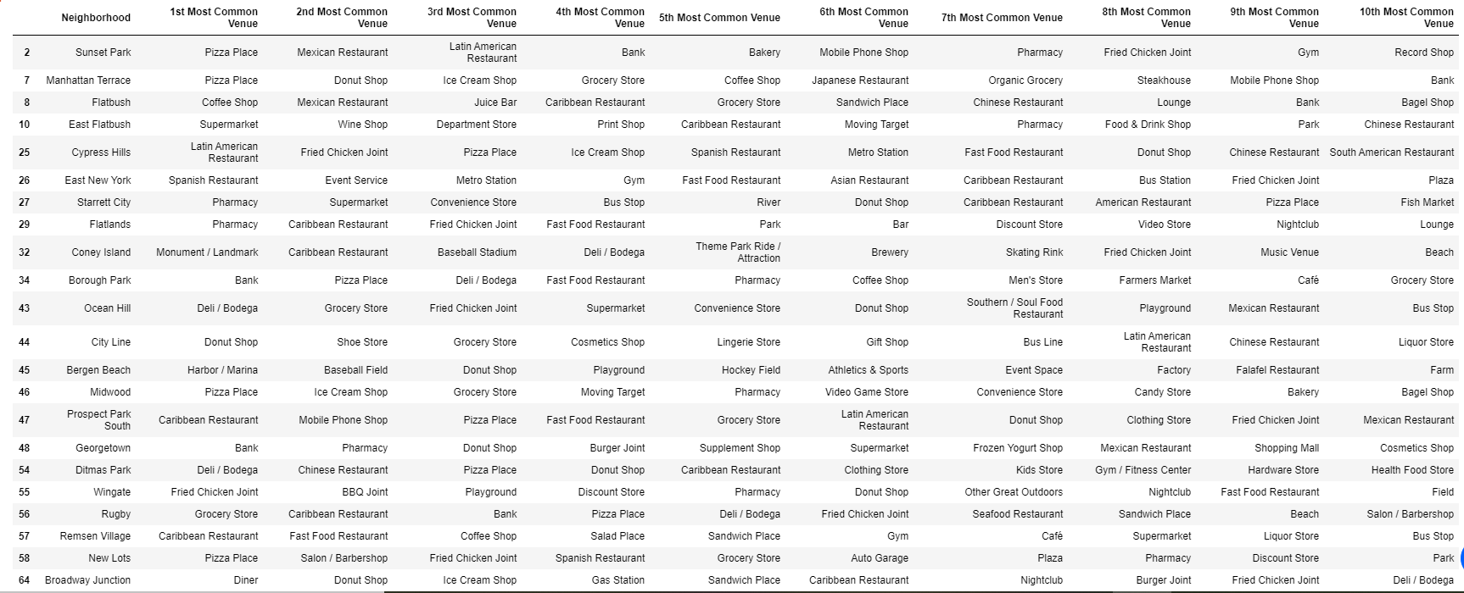
Data Analysis
Cluster 1
Cluster 1 contains a robust amount of nearby venues and will be an optimal location for the new brewery.

Slide 6
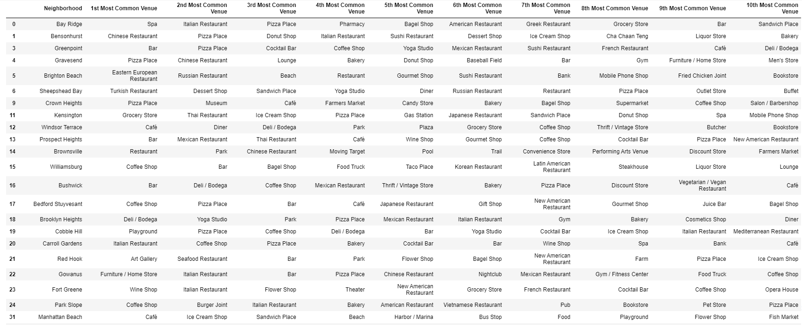
Data Analysis
Cluster 4
Cluster 4 also contains a robust amount of nearby venues and will be an optimal location for the new brewery.

Slide 7
Data Analysis
Cluster 2
Cluster 3
Cluster 5
Clusters 2, 3, and 5 are not optimal locations for the location of a new brewery. They appear to be more suburban or rural locations and wouldn’t attract many visitors.

Slide 8
Conclusion
Starting a brewery in Brooklyn would be viable if the right location were selected. The analysis contained within this presentation is a good starting point to further examine, and narrow down, the appropriate location for this business. Initial analysis indicates that the neighborhoods in Cluster 1 and Cluster 4 would be an initial starting point for possible locations.
Factors not included in this presentation are available properties to rent/purchase, and the infrastructure (utilities, water, electricity, parking) needed for this venture.
An analysis of transit routes such as subway and bus stations would also assist in the search for a location.

